Slide 1

Hospital Analytics Dashboard Using Streamlit
Comprehensive Design, Features, and Insights
Team members:
Paul I. Kehinde
3, December, 2024

Slide 2
DATA NEEDS FOR EFFICIENT HEALCARE SYSTEMS
Electronic Medical Records (EMR)

Slide 3
DATA NEEDS FOR EFFICIENT HEALCARE SYSTEMS
Health Systems Data

Slide 4
DATA NEEDS FOR EFFICIENT HEALCARE SYSTEMS
Population Health Data

Slide 5
ABOUT US
Helpman Techechnologies (HelpTech) is a premier provider of analytics and services in data science, specializing in research support and transforming complex data into actionable insights.

Slide 6
Computational Services
Data Analysis & Visualization
Big Data Analytics
Machine Learning & AI
Customized Software Solutions
Research Services
Market Research & Forecasting
Innovation & Technology Assessment
Policy Impact Analysis

Slide 7
Background
Hospitals are under increasing pressure to improve the quality of care while managing costs effectively.
Healthcare analytics acts as a magnifying glass, illuminating bottlenecks, waste, and underutilized resources within these intricate processes.
The regulatory landscape in healthcare is continually evolving, with an increasing emphasis on data-driven quality improvement and accountability.

Slide 8
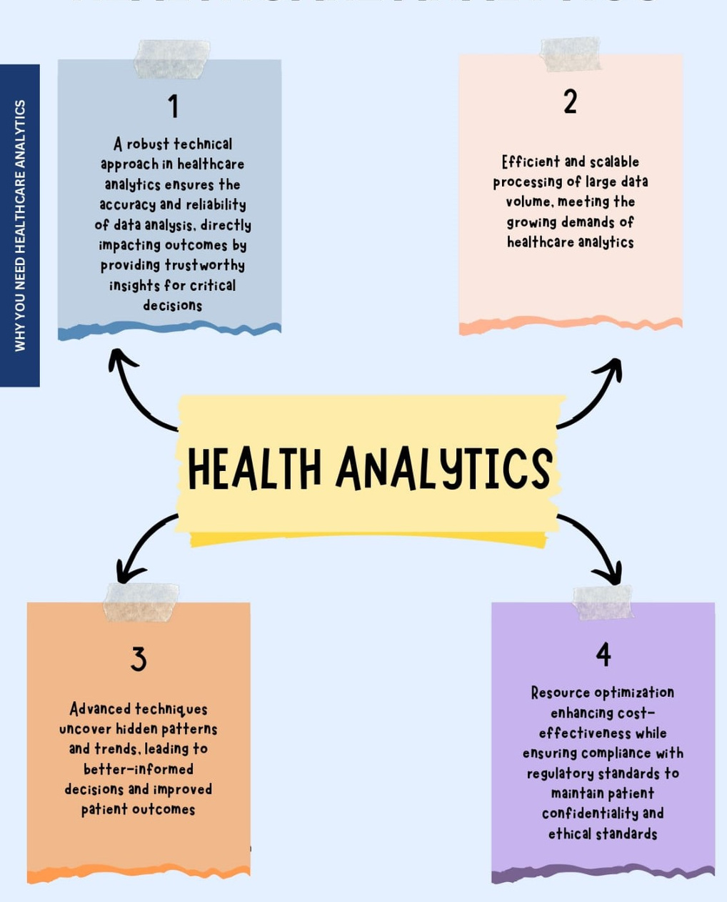
Why you need Healthcare Analytics

Slide 9
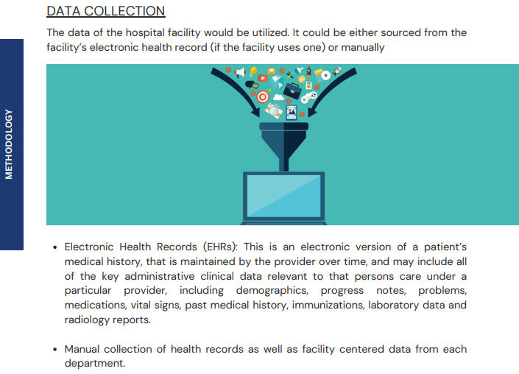
Our Methodology

Slide 10
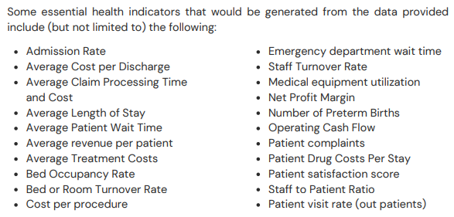

Slide 11
Resources and technologies used
Validation and testing
Documentation
Evaluation criteria
Feedback and iteration

Slide 12

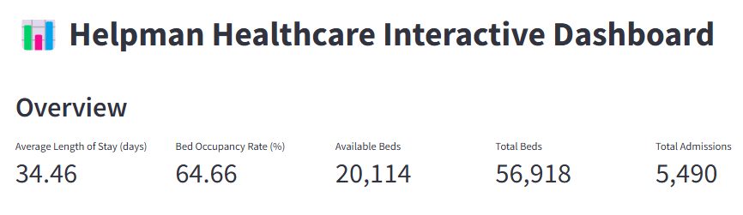

The Overview Page dynamically updates to display real-time data from various departments. Users can click on specific metrics to navigate to more detailed sections.
The Overview Page is the starting point, it provides a summary of the hospital's key metrics, including daily admissions, discharges, bed occupancy rates, revenue, and patient satisfaction.
01

Slide 13
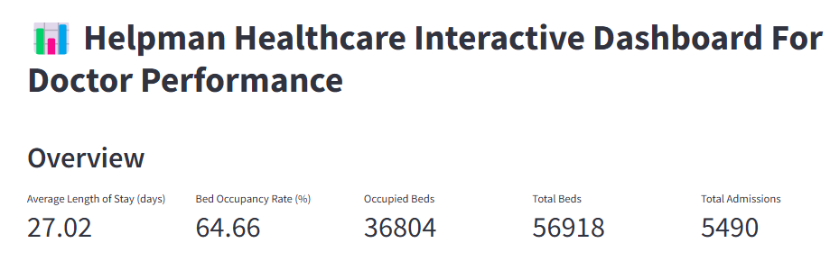
The Overview Page is the starting point, it provides a summary of the hospital's key metrics, including daily admissions, discharges, bed occupancy rates, revenue, and patient satisfaction.
The chart indicating trends in daily admissions over the past month, highlighting any noticeable spikes or declines.
01

Slide 14
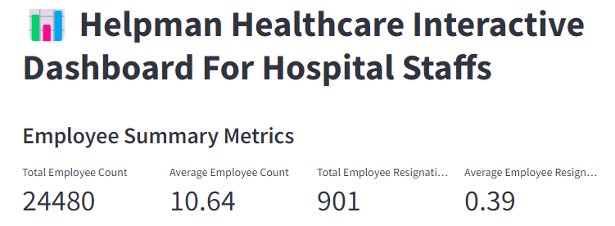
It help in monitoring total resignations is crucial for understanding staff turnover, workforce stability, and the potential need for recruitment or retention strategies
This metric reflects the overall workforce capacity, highlighting the hospital's ability to maintain a robust staff to meet patient care needs.
01

Slide 15
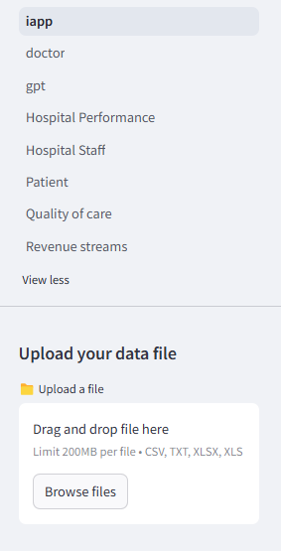
SIDEBAR FUNCTIONALITY
The Sidebar provides easy navigation across different dashboard sections:
Patients
Operations
Financials
Quality of Care

Slide 16
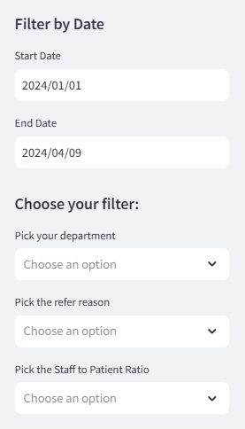
SIDEBAR FUNCTIONALITY
Users can use the Sidebar to refine data by selecting specific departments or date ranges, which automatically updates the dashboard content.

Slide 17
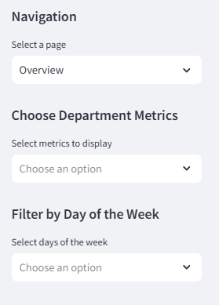
SIDEBAR FUNCTIONALITY
The navigation page contains different sections and cover different metrics as follows:
Patients Section: Displays metrics like daily admissions, wait times, readmission rates, and patient-to-staff ratios.
Operations Section: Tracks operational data such as bed occupancy, equipment usage, and average discharge times.
Financials Section: Provides insights into revenue, costs, profit margins Etc.

Slide 18
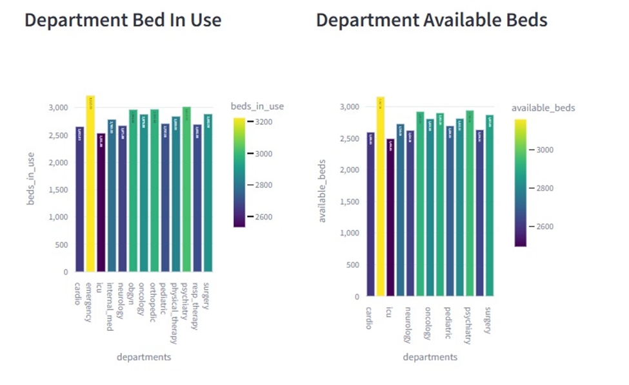
Department Available Beds
The following diagrams are excerpts that give a real time interactive feature of the dashboard:

Slide 19
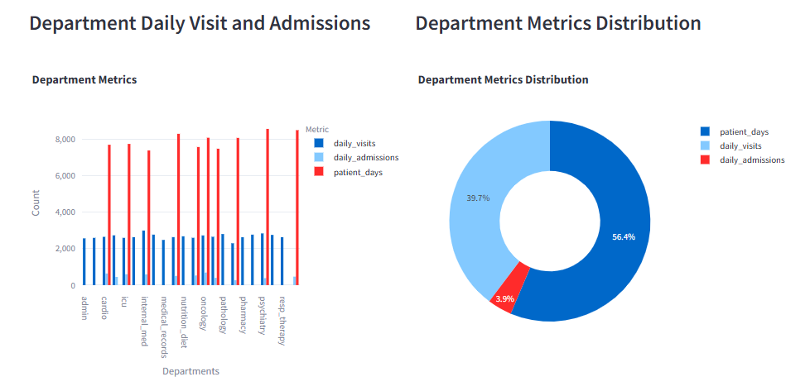
Department Available Beds
The following diagrams are excerpts that give a real time interactive feature of the dashboard:

Slide 20
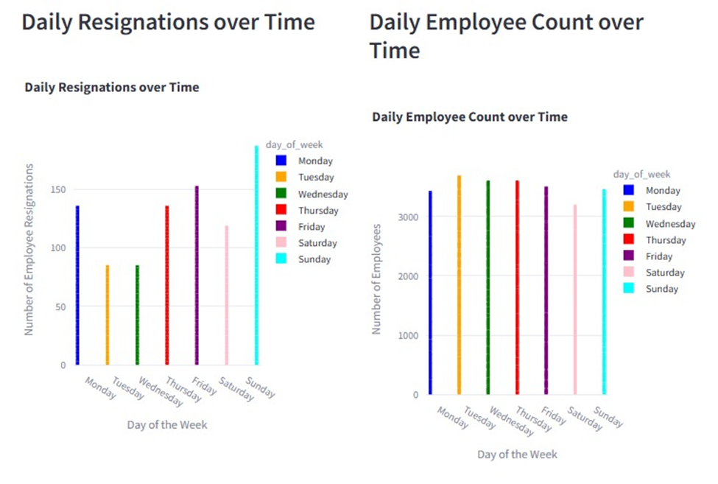
Department Available Beds
The following diagrams are excerpts that give a real time interactive feature of the dashboard

Slide 21
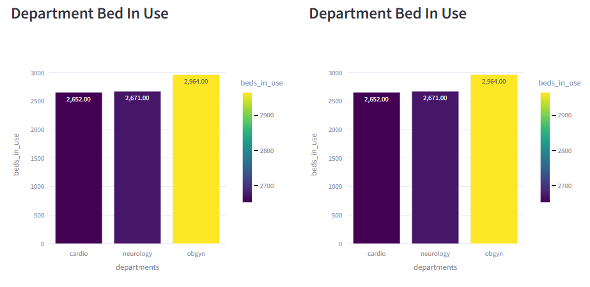
Time Series Analysis
The following diagrams are excerpts that give a real time interactive feature of the dashboard

Slide 22
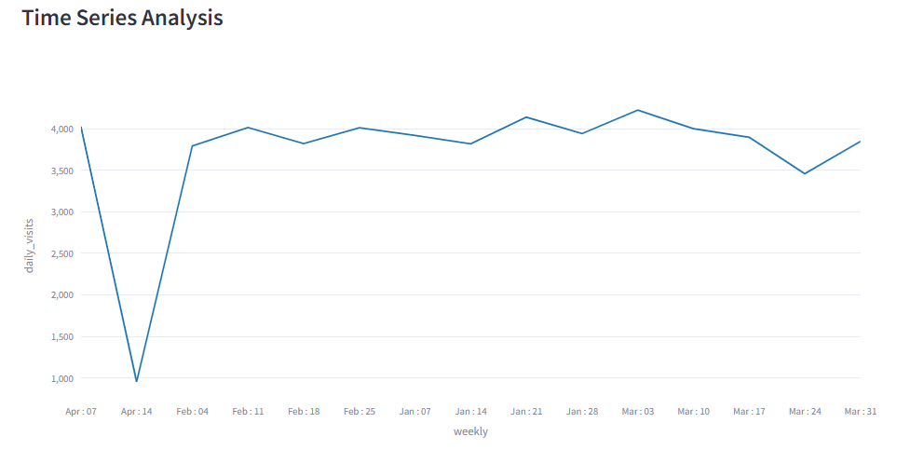
Time Series Analysis
The following diagrams are excerpts that give a real time interactive feature of the dashboard

Slide 23
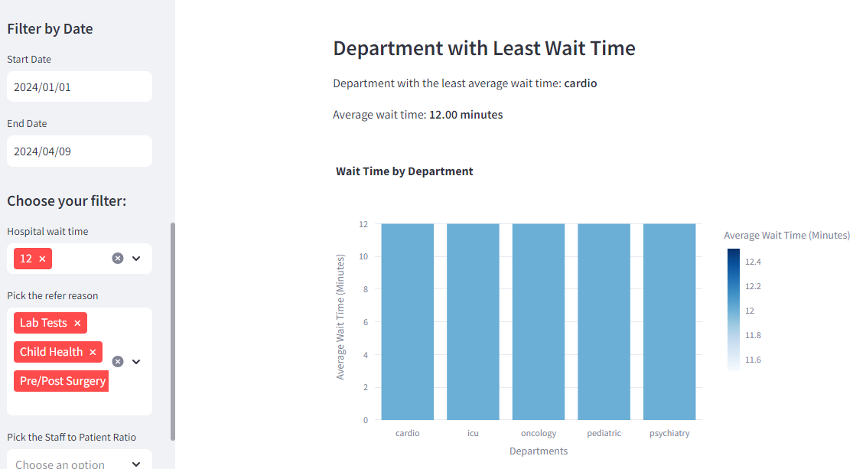
Department Filtering by Wait Time
The following diagrams are excerpts that give a real time interactive feature of the dashboard

Slide 24
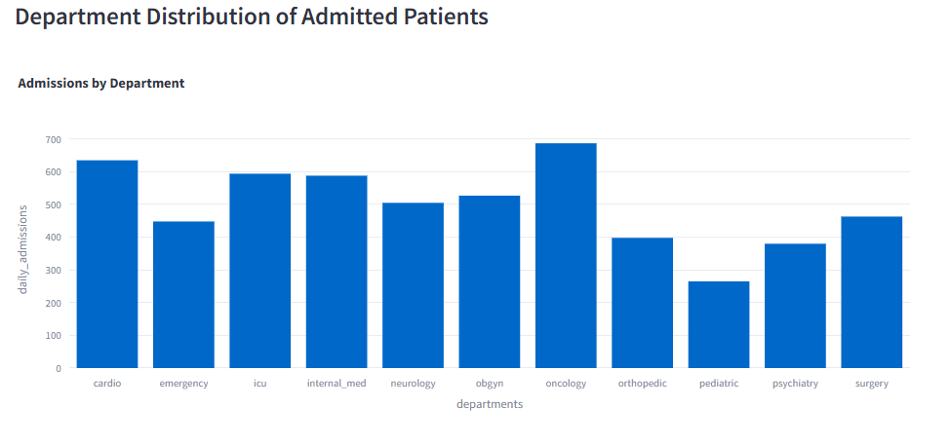
Enhanced Decision-Making Tools: With visual comparisons between admission distribution staff can better allocate resources, optimize patient care strategies, and make data-driven decisions to enhance overall hospital performance.

Slide 25
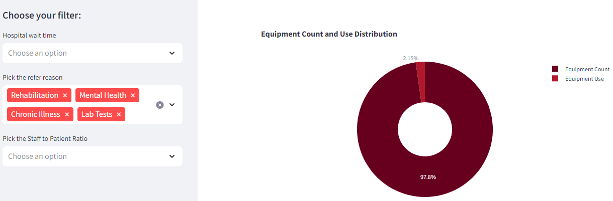
Enhanced Decision-Making Tools: With visual comparisons between equipment usage by wait times, staff can better allocate resources, optimize patient care strategies, and make data-driven decisions to enhance overall hospital performance.

Slide 26
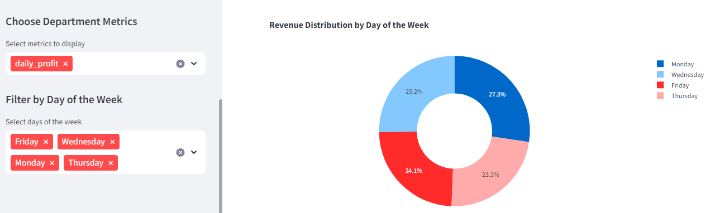
This dashboard provides key metrics like daily profit helping staff and administrators understand performance across various departments. The ability to filter by days of the week (e.g., Friday, Wednesday, etc.) enhances the analysis of trends related to hospital usage and operational demands.
10

Slide 27
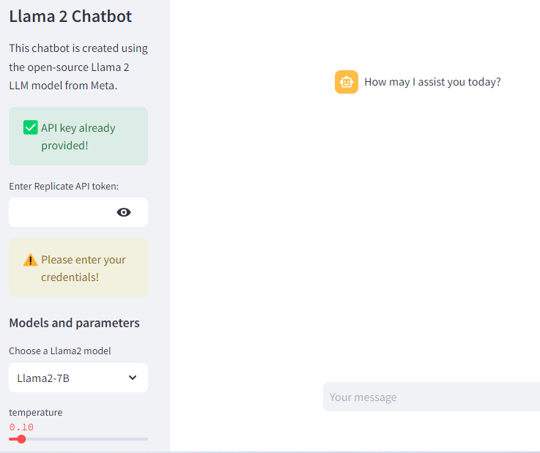
Interactive Data Querying: The chatbot enables staff to quickly retrieve and interact with specific healthcare metrics, such as "daily visits" for different departments.
Personalized Assistance: By integrating with the healthcare dashboard, the chatbot offers a conversational interface for staff to ask questions, access patient metrics.
10

Slide 28
Future Enhancements and Q&A
Outline planned upgrades, such as predictive analytics for patient outcomes or expanding the dashboard to cover additional departments.
Plans to incorporate AI-based alerts for critical metrics.
Results: Future enhancements will provide deeper insights and proactive management capabilities.
The key benefits of this dashboard include:
improved operational efficiency
real-time insights
better data-driven decision-making.

Slide 29



Thank you!

